Slide 1



CLPS Incorporation
Nasdaq: CLPS

Slide 2
Chapter 17
Spring Integrates MyBatis
CLPS Incorporation

Slide 3
Catalogue
1. Environment building
2. Write configuration files related to SSM integration
2. MyBatis下载与安装
3. Create entity class
2. MyBatis下载与安装
4. Data access layer development
5. Business logic layer development
2. MyBatis下载与安装
6. Controller development
7. Presentation layer development

Slide 4
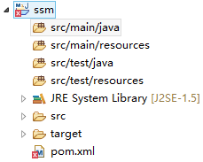
17.1 Environment Building
In eclipse, create a new Maven project called SSM.
Project initial directory structure analysis.
Set up the relevant features of project SSM.
Add the jar package required by SSM framework to the project.

Slide 5
17.2 Write configuration files related to SSM integration
To realize the integration of spring, spring MVC and mybatis framework, we need to write the main configuration file web.xml, spring configuration file and spring MVC configuration file of web application.
Write web.xml file
Write spring MVC configuration file
Write spring configuration file

Slide 6
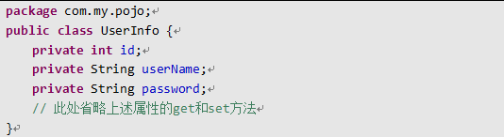
17.3 Create entity class
In the Src / main / Java directory, create a new com.my.pojo package, and create a new entity class userinfo in the package 。

Slide 7
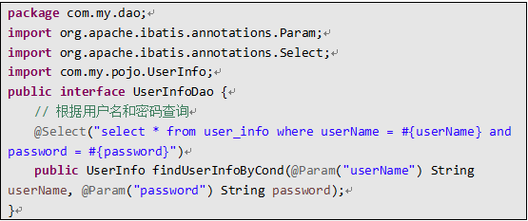
17.4 Data access layer development
In the Src / main / Java directory, create a new com.my.dao package to store the data access layer interface. Create a new interface userinfodao in the package and declare the method in the interface.

Slide 8
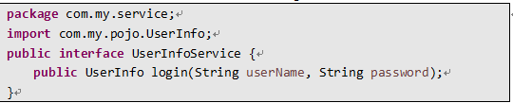
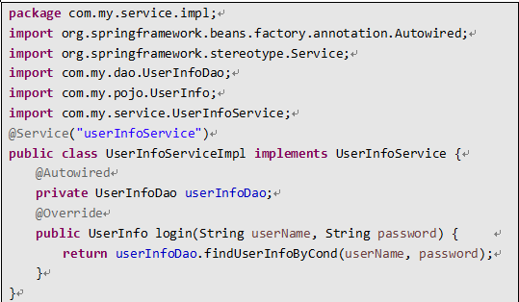
17.5 Business logic layer development
In the Src / main / Java directory, create a new com.my.service package to store the business logic layer interface. Create a new interface userinfoservice in the package, and declare a login method in the interface for login authentication.
Create a new implementation class of the userinfoservice interface, serinfoserviceimpl, and store it in the com.my.service.impl package to implement the login method.

Slide 9
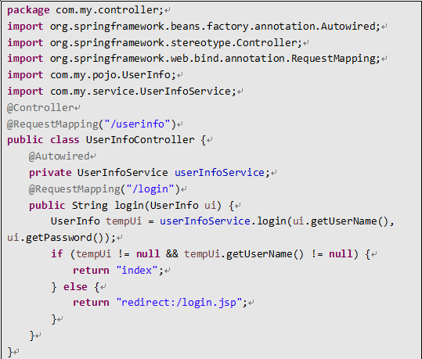
17.6 Controller development
In the Src / main / Java directory, create the package com.my.controller to store the controller class. Create a new class userinfocontroller in the package 。

Slide 10
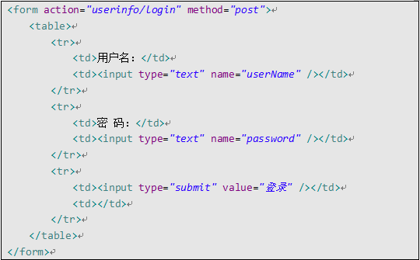
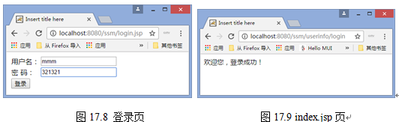
17.7 Presentation layer development
In the Src / main / webapp directory, create a new login page login.jsp .

Slide 11
17.8 Review
In this chapter, we first build an environment for the integration of spring, spring MVC and MyBatis framework, as well as the compilation of related configuration files are explained. Then, according to the data table user_info, taking user login as an example, following the three-tier architecture, according to the process of entity class creation, data access layer development, business logic layer development, controller development and presentation layer development, a complete description of the realization process of a functional module is given.

Slide 12

Thank You

